Slide 1
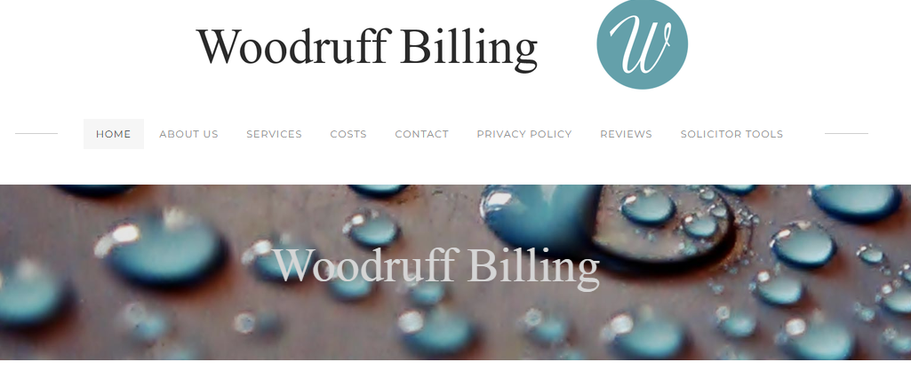

Where to Find the Uplift Justification Collator Tool: Goto https://www.woodruffbilling.co.uk/
In the top right corner click on: ‘SOLICITOR TOOLS’
You will be asked for a Password: Type “West Pier” and hit the ENTER . button.
Where to Find the Uplift Justification Collator Tool: Goto https://www.woodruffbilling.co.uk/

